Slide 1
R Workshop – Day 2
Randi L. Garcia
Smith College
July 17th, 19th, and 21st

Slide 2
Day 2
ANOVA and regression
Preparing APA style manuscripts
Exploratory Factor Analysis (EFA) and Confirmatory Factor Analysis (CFA)
Path Analysis and SEM

Slide 3
ANOVA and Regression
Analysis of Variance (ANOVA) is used to compare the means of a numerical variable across levels of a categorical variable (3+ levels)
Only 2 levels, what test do we use?
Simple Linear Regression (SLR) is used to find the relationship between one numerical predictor variable and one numerical response (outcome or DV) variable.
Multiple Regression is used to find the relationship between predictor and response controlling for other variables.

Slide 4
ANOVA and Regression
Logistic Regression is used to model the probability of being in a certain group based on numerical predictors.
i.e., The response variable is dichotomous
This is called a Generalized Linear Model (GLM)
χ²-Test (Chi-squared Test) is used to test if two categorical variables are associated.
For example, is the distribution of education levels more skewed towards higher degrees for men than for women?

Slide 5
ANOVA and Regression
 | Response (DV or outcome variable)
Explanatory (IV or predictor) | Numerical | Categorical (2 levels: dichotomous)
Categorical (levels = 2) | t-Test | χ²-Test (two-prop test)
1 Numerical | SLR | Logistic Regression
Categorical (levels >= 3) | ANOVA | χ²-Test
2 or more Numerical | Multiple Regression | Logistic Regression

Slide 6
ANOVA and Regression
Inference Test | R function
t-Test | t.test()
ANOVA | aov()
SLR and Multiple Regression | lm()
χ²-Test | chisq.test()
Logistic Regression | glm()

Slide 7
R Markdown file

Slide 8
Preparing APA Style Manuscripts
Connie Zhang, 19’ and Emma Ning, 19’

Slide 9
Exploratory Factor Analysis (EFA)

Slide 10
Confirmatory Factor Analysis (CFA)
data(HolzingerSwineford1939)
Mental ability test score from 7th and 8th grade children from two schools
A visual factor measured by 3 variables: x1, x2 and x3
A textual factor measured by 3 variables: x4, x5 and x6
A speed factor measured by 3 variables: x7, x8 and x9
We want to test if indeed these measures fall on these three scales as we hypothesize.
We are confirming a hypothesized factor structure instead of exploring.

Slide 11
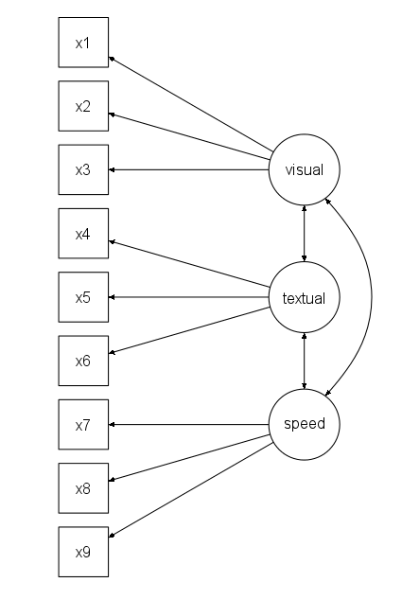
Visual factor: x1, x2 and x3
Textual factor: x4, x5 and x6
Speed factor: x7, x8 and x9

Slide 12
Confirmatory Factor Analysis (CFA)
We will use the R package lavaan to fit CFAs
most widely used Structural Equation Modeling (SEM) package in R.
Step 1: Specify the model
Step 2: Fit the model
Step 3: Ask for the output you want

Slide 13

Step 1: Specify the Model

Slide 14
Step 2: Fit the Model

Slide 15
Step 3: Ask for the output you want

Slide 16
Path Analysis and SEM

Slide 17
R Markdown file

